Slide 1
DEPARTMENT OF ELECTRICAL AND ELECTRONICS ENGINEERING
18EEP401L-MINOR PROJECT – IV
FINAL REVIEW
Borewell water overflow Detection and Prevention system
YEAR/ SEMESTER – III/VI
BATCH NUMBER :12
DATE : 13.05.2025
GUIDED BY:
Mr. N Selvam M.E
Assistant Professor/EEE
PRESENTED BY: NALIN KUMAR S P (927622BEE073)
SANJAAI U N (927622BEE094)
SHARMITHA S P (927622BEE106)

Slide 2
PROBLEM STATEMENT
Autoflow wells in the Terai region rely on naturally pressurized aquifers to supply water without pumps. However, many private wells remain uncapped, leading to uncontrolled water discharge and wastage. Additionally, the constant flow makes it difficult to measure water levels, which is essential for groundwater monitoring and management. These challenges contribute to groundwater depletion and waterlogging in agricultural fields, affecting both water security and land productivity.

Slide 3
OBJECTIVE
Prevent continuous water loss by integrating a manually controlled tap to regulate outflow.
Monitor well conditions using an Arduino-based system with water level and pressure sensors.
Provide real-time data to help users make informed decisions for groundwater conservation.
Improve well management by enabling efficient water use and reducing the risk of over-extraction.
Support sustainable groundwater utilization by offering a cost-effective and adaptable solution.

Slide 4
ABSTRACT
The Borewell Water Level and Pressure Monitoring System is designed to ensure effective management of borewell water levels and pressure using an Arduino Uno. The system incorporates three water level sensors to detect different water levels and an HX710B Pressure Sensor to measure water pressure in real time. Based on sensor data, the Arduino controls LEDs to indicate water levels and sends SMS alerts using a GSM module when critical conditions are detected. Additionally, the measured pressure is displayed on the Serial Monitor in Bar units. This system provides a cost-effective and reliable solution for water management, preventing water wastage, monitoring borewell status, and enhancing operational safety.

Slide 5
INTRODUCTION
The Borewell Water Level and Pressure Monitoring System is designed to ensure the efficient management of borewell water levels.
It monitors water levels using three sensors and checks borewell pressure using an HX710B Pressure Sensor.
The system uses an Arduino Uno to process data and send alerts through a GSM module in case of abnormal conditions.

Slide 6
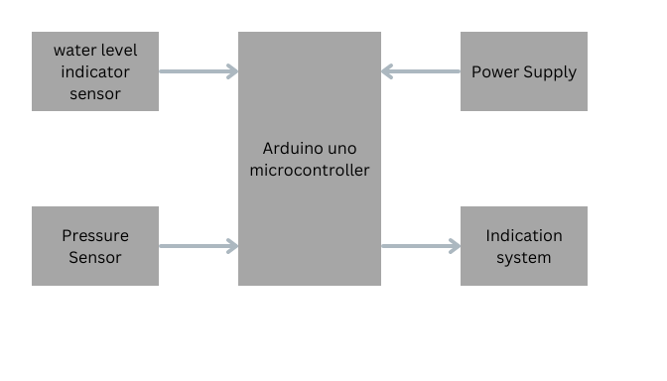
BLOCK DIAGRAM

Slide 7
DESCRIPTION
Autoflow wells in the Terai region rely on naturally pressurized aquifers to supply water without the need for pumps.
While these wells provide a continuous and reliable water source, many private wells remain uncapped, leading to uncontrolled water discharge, wastage, and inefficient groundwater use.
To address these issues, this project proposes a smart well cap that integrates a manually controlled tap and an Arduino-based monitoring system. The tap allows users to regulate water flow, preventing unnecessary discharge and promoting efficient usage.

Slide 8
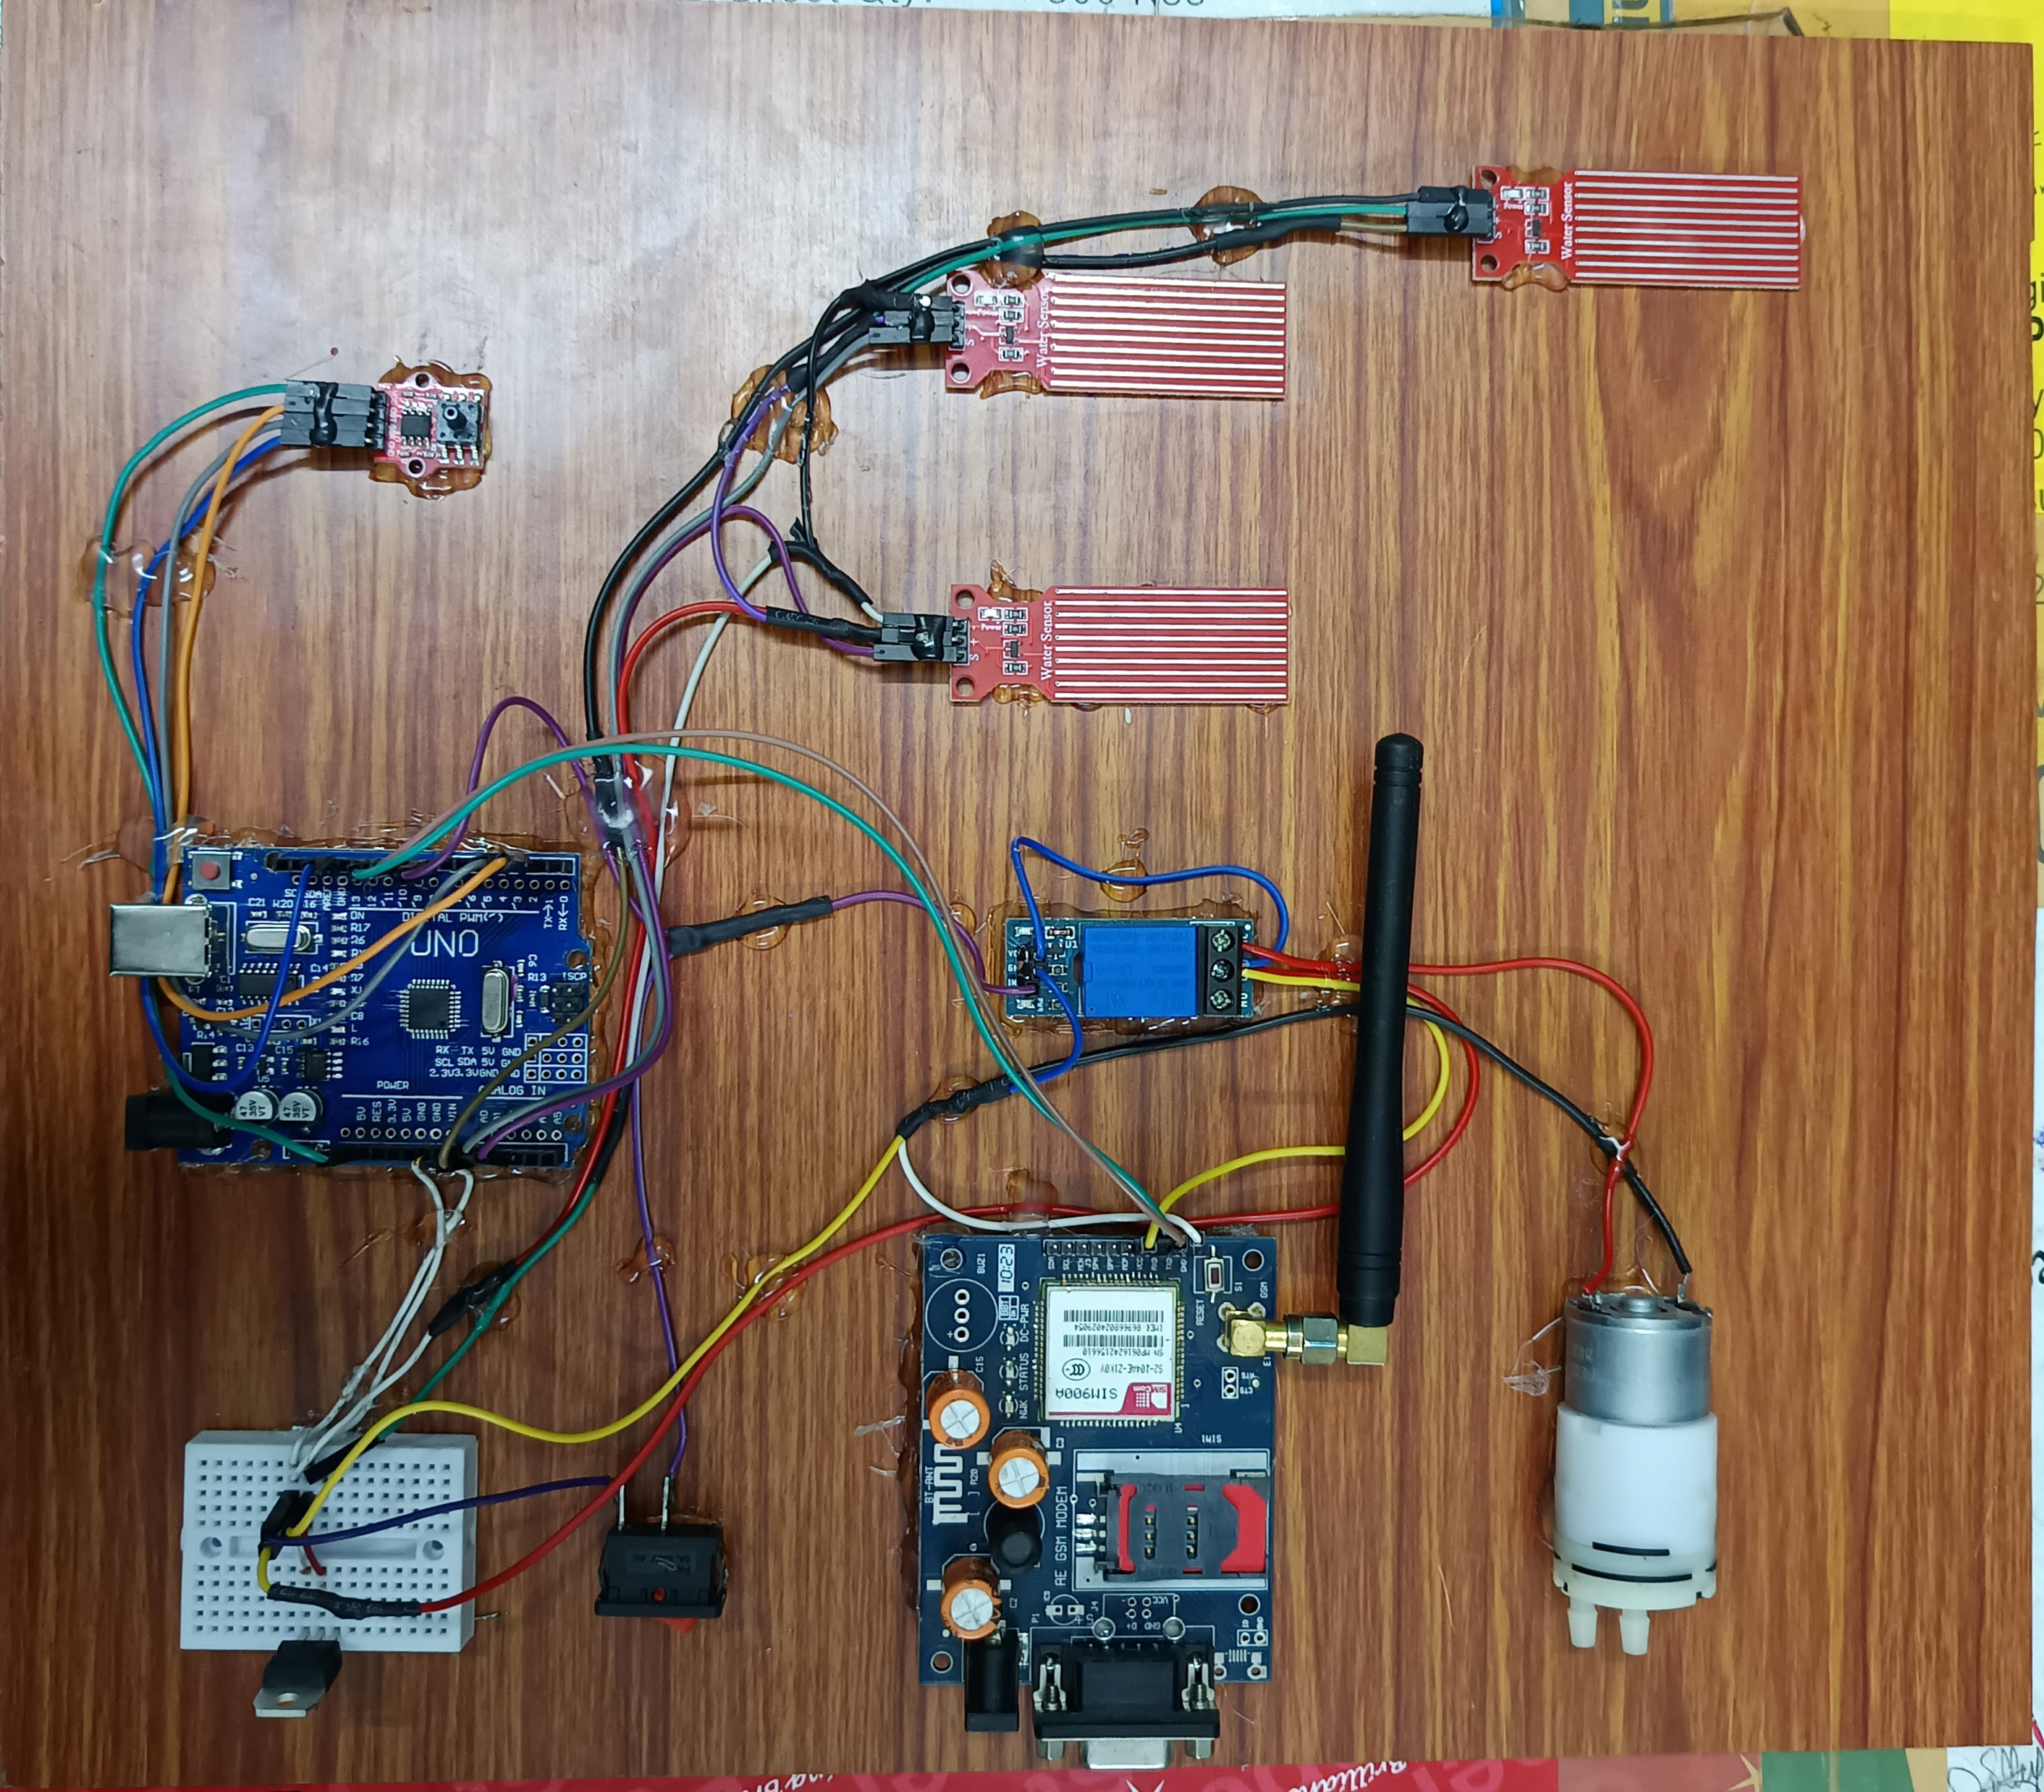
PROJECT KIT

Slide 9
WORKING
Sensor 1 Activates a Green LED if the water level is safe.
Sensor 2: Sends an SMS alert if a highwater level is detected.
Sensor 3: Triggers a drain valve and sends an SMS if the water overflows.
The HX710B Pressure Sensor measures the water pressure. The pressure is displayed in Bar on the Serial Monitor.
The GSM Module sends real-time SMS alerts to a specified phone number during critical water levels.
The Arduino continuously monitors sensor readings and makes decisions to activate LEDs or send alerts.

Slide 10
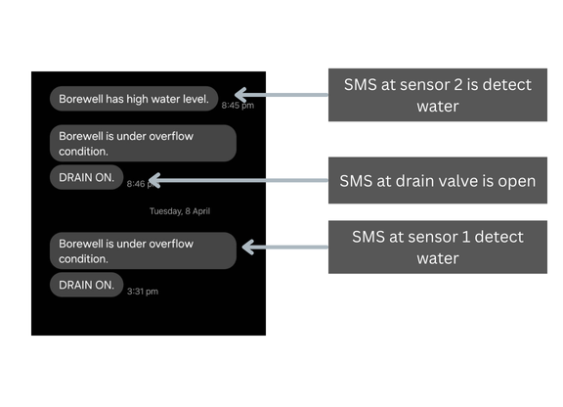
SMS ALERTS

Slide 11
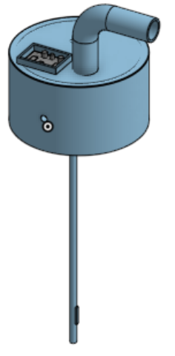
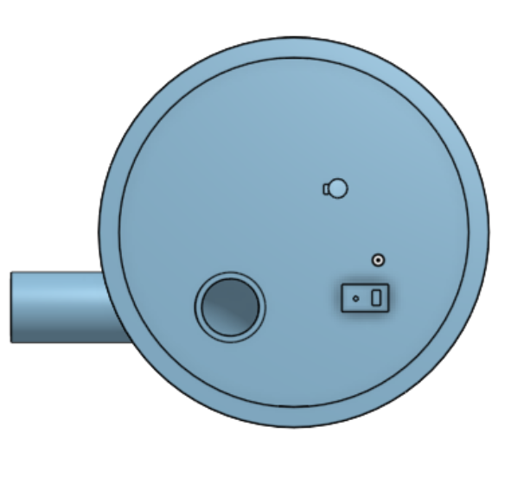
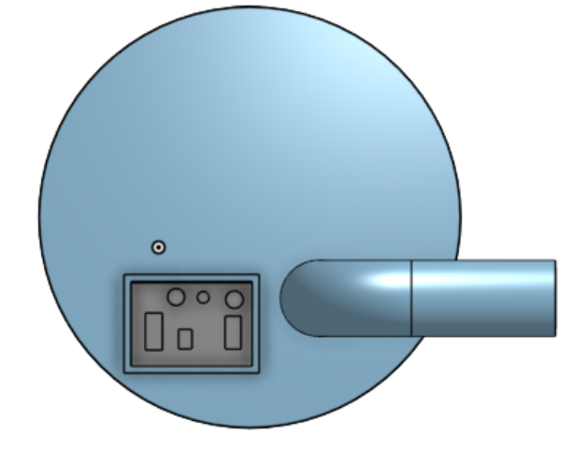
3D DESIGN
Front view
Top view
Bottom view

Slide 12
COST ESTIMATION
s.no | Name of the components | quantity | cost
01 | Arduino UNO | 1 | 650
02 | Water Level sensor | 1 | 150
03 | Pressure sensor | 1 | 100
04 | Water Pump | 1 | 250
05 | LCD Display | 1 | 150
06 | Pipes and Fittings | Few | 500
07 | Others |  | 1000
08 |  | Total | 2650

Slide 13


